Slide 1

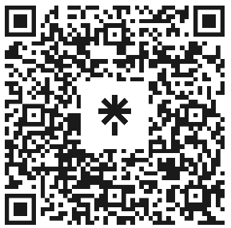

Welcome to Code Crunch!
Attendance
linktr.ee/CODE.CRUNCH

Slide 2
Welcome to Code Crunch!
•Code Crunch is your go-to platform for collaboration, networking, and hands-on projects. We welcome freshmen, graduates, and alumni from any university, regardless of major or experience level.
•Join us virtually via Zoom or in person at Florida International University. Together, we’ll break down barriers in technology, learn through immersive workshops, and build innovative solutions.

Slide 3
Our Mission & Vision
Mission:
Our mission is to equip students with the technical skills and professional connections needed to excel in coding interviews and beyond. We provide a platform where students can collaborate, learn, and grow professionally while emphasizing the importance of diversity and inclusion in the tech industry
Vision:
We strive to bridge the gap between academia and the tech industry by offering hands-on workshops, technical interview preparation, hackathons, and networking opportunities with experts from leading companies. Our vision is to empower students from all backgrounds to achieve their full potential, foster an inclusive tech community, and build a strong, supportive alumni network. By covering a wide range of technical areas, we aim to prepare students for success in a variety of tech careers.

Slide 4
What We Offer
• Hands-On Workshops: Topics include Python, JavaScript, React, and more.
• LeetCode Prep: Weekly sessions to master technical interviews.
• Hackathons: Collaborate on innovative projects in a competitive setting.
• Panel Discussions: Industry leaders from tech giants and startups share insights.
• Global Access: Code Crunch Global launches in October for worldwide participation!

Slide 5
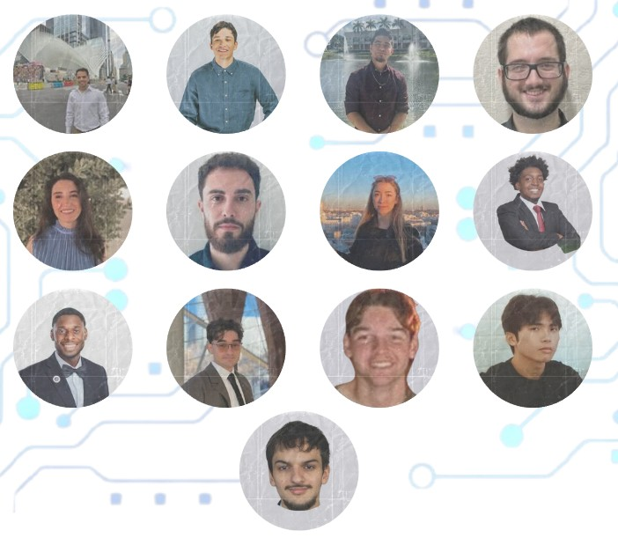
Meet the E-Board
President: Brian Bazurto
Vice President: Amilcar Pena
Treasurer: Bryan Garcia
Marketing/Logistics: Henry Cruz
Logistics: Jason Liang
Tech Leads:
Alvise Carpin
Arnold Miranda
Daniel Hernandez
Gabriel Nogueras
Justin Joseph
Mariana Phelan
Sara Salvatierra
Thierry Laguerre
Notes:
Our leadership team is dedicated to creating a supportive and inclusive space for all members. Join our team and make an impact! Apply for open roles today!

Slide 6
Why Join Code Crunch?
• Collaborate with peers and mentors.
• Develop technical and leadership skills.
• Network with professionals from top companies.
• Build impactful projects and gain hands-on experience.
A welcoming and inclusive space for underrepresented groups in tech.

Slide 7
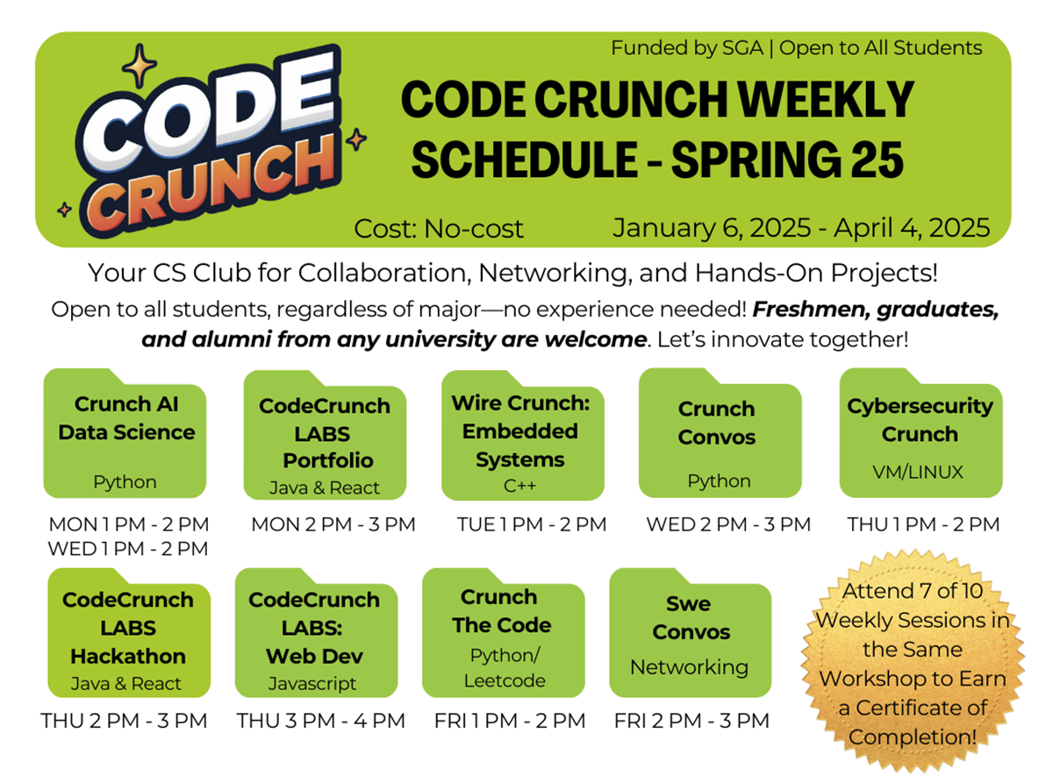
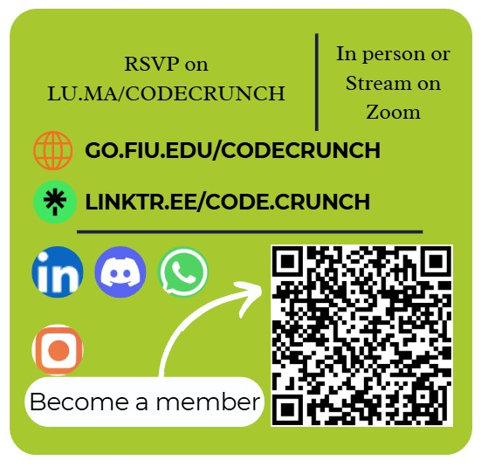
Spring 2025 Weekly Schedule

Slide 8
Be Part of the Code Crunch Community
1. RSVP for sessions at go.fiu.edu/codecrunch.
2. Follow us on LinkedIn, Instagram, and Discord for updates.
3. Become a member using the QR code on this slide.
4. Attend workshops, participate in events, and join our leadership team.
Together, we innovate and grow.

Slide 9
What we offer C6 Cyber Crunch
What to expect
Learning Modules
Learn about networking, ethical hacking, cryptography, incident response, and more.
Hands-On Labs and Workshops
Practical exercises will help reinforce your learning.
Tools: TryHackMe, Wireshark, Nmap, and more.
Real-world scenarios and challenges to prepare you for practical cybersecurity roles.
Capstone Project
Apply everything you've learned in a capstone project, where you’ll tackle a real-world cybersecurity challenge.
Build secure applications, perform vulnerability assessments, or create encryption-based solutions.
Career Insights and Guidance
Exposure to different career paths in cybersecurity, mentorship, and discussions about the industry’s current trends.

Slide 10
Key Dates & Structure
C6 | Cyber Crunch
Cyber Crunch: Workshop Structure
Introduction to Cybersecurity
Topics: Overview of Cybersecurity, Threats and Vulnerabilities, Careers in Cybersecurity.
Lab: Discuss famous cybersecurity breaches, set up TryHackMe.
Linux Fundamentals
Topics: Overview of Linux, Linux command lines, why use Linux in Cybersecurity.
Lab: Linux Basics with TryHackMe, File System Scavenger Hunt.
Networking Fundamentals
Topics: Networking overview, IP Addressing, subnets and gateways, protocols, tools (Wireshark, Nmap, Firewalls and VPNs).
Lab: Packet Tracing Challenge.
Cryptography
Topics: What is Cryptography, Symmetric vs. Asymmetric Encryption, Hashing Algorithms (SHA, MD5), Cryptography in Cybersecurity.
Lab: Message Encryption and Decryption.
Ethical Hacking
Topics: What is ethical hacking, types of hackers, careers in ethical hacking
Lab: Penetration Testing on a simulated environment.

Slide 11
Key Dates & Structure
C6 | Cyber Crunch
Cyber Crunch: Workshop Structure
6. Web Application Security - Topics: What is Web Security, common Vulnerabilities (SQL Injection, XSS, CSRF), OWASP Top 10 Overview, securing web applications. - Lab: Web Application Attack Simulation, set up a basic web application and test for vulnerabilities. 7. Threat Detection and Incident Response - Topics: Overview of Threat Detection and Incident Response, intrusion detection systems (Snort, Suricata). - Lab: Simulated Incident Response 8. Operating Systems Security - Topics: Securing Windows and Linux Systems, understanding file permissions and access control, logging and monitoring. - Lab: Practice securing a Linux environment, review Windows Security Event Logs. 9. Security Tools and Practices - Topics: Firewalls, endpoint security solutions - Lab: Set up and configure a simple firewall using pfSense. 10. Capstone Project and Presentation - Build a secure web application and identify vulnerabilities. - Perform a vulnerability assessment of a simulated network. - Create a cryptography-based secure messaging application.

Slide 12
Let’s Innovate Together!
Thank you for joining us on this exciting journey! Code Crunch is redefining tech education and fostering inclusivity in technology. Let’s collaborate, innovate, and create a brighter future together.
RSVP for sessions today. Follow us on social media. Spread the word about Code Crunch!
#CodeCrunch #CodeCrunchFIU #DiversityInTech #InclusiveTech #LeadershipOpportunities #FIUTechCommunity #WomenInSTEM #LGBTQInTech #LatinxInTech #BlackInTech #AAPIsInTech #TechLeadership #JoinOurTeam #FIUInnovation #TechForEveryone #EmpowerTech #FutureLeaders #HackerCulture #CodeYourFuture #TechDiversity #FIUPanthers #STEMOpportunities #BuildYourFuture #LeadWithCode #PanthersInTech

Slide 13
Q&A Session

Slide 14





Attendance
Join us for the upcoming weekly sessions this Spring 2025!
Monday: 1PM & 2PM
Tuesdays: 1PM
Wednesdays: 2PM
Thursdays: 1PM , 2PM & 3PM
Friday: 2PM & 3PM
RSVP LU.MA/CODECRUNCH
Your feedback helps us improve. Share your thoughts! Go to our website: go.fiu.edu/codecrunch

